Slide 1
QuantTree EWMA
Report of Results

Slide 2
Generating Sequences
Explanation on how the training data and sequences are generated

Slide 3
Sequence Generation (1/2) - Inputs
Scenario 0
d
Φ₀
s
For each iteration of the experiments (each time we run quantree), we shuffles the indexes of these vectors, from which we generate the sequences (next slide).
Scenario 1
d
Φ₁
s
d is the number of dimensions/variables
s is the number of samples/days
Φ₀ is the distribution of scenario 0
Φ₁ is the distribution of scenario 1

Slide 4
Sequence Generation (2/2) - Outputs
N
s - N
d
Φ₀
Φ₀
Sequence 0 (no change and non overlapping with training data)
Training data
(same for both sequences)
Sequence 1 (with change)
d
Φ₀
Φ₁
s
N
N is the moment where the change happens, from which we start to monitor on QuanTree EWMA.
d is the number of dimensions/variables in the sequence
s is the number of samples/days
Φ₀ is the distribution of scenario 0
Φ₁ is the distribution of scenario 1

Slide 5
Sanity Check
Artificially generated data to check implementation
Scenario 0 → Scenario 1
The distribution under Scenario 0 is gaussian and under Scenario 1 is poisson.

Slide 6
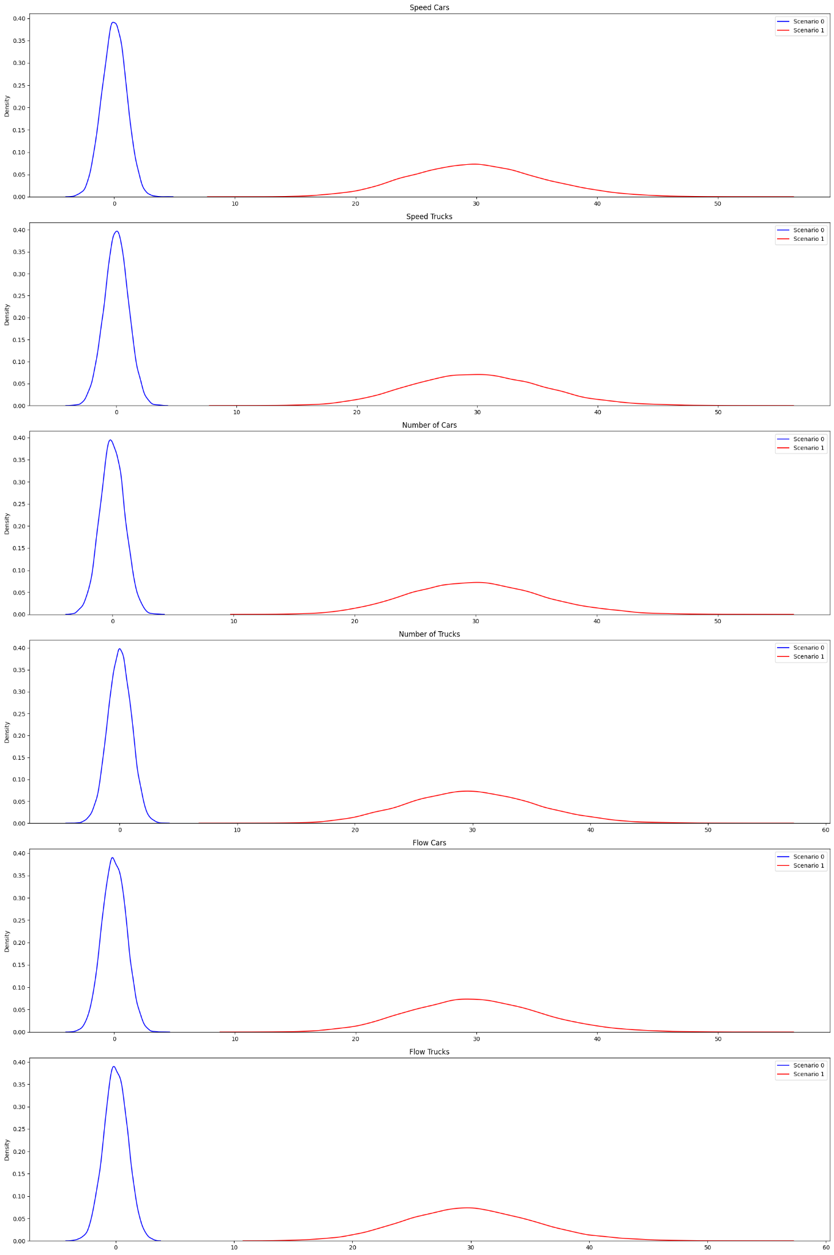
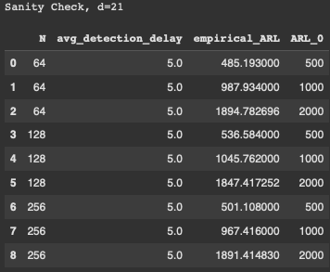
Sanity check (d=21), qtree ewma (K=32)

Slide 7
Poisson
Inflows generated with poisson distribution
Multimodal: Weekday (100%) + Weekend (0%)
Scenario 0 → Scenario 1
The change is minimal: 5 seconds longer in a single red phase of a single traffic light.
Here we are considering only the weekdays.
Here we do not take into account “flow cars” or “flow trucks” when running QT EWMA

Slide 8
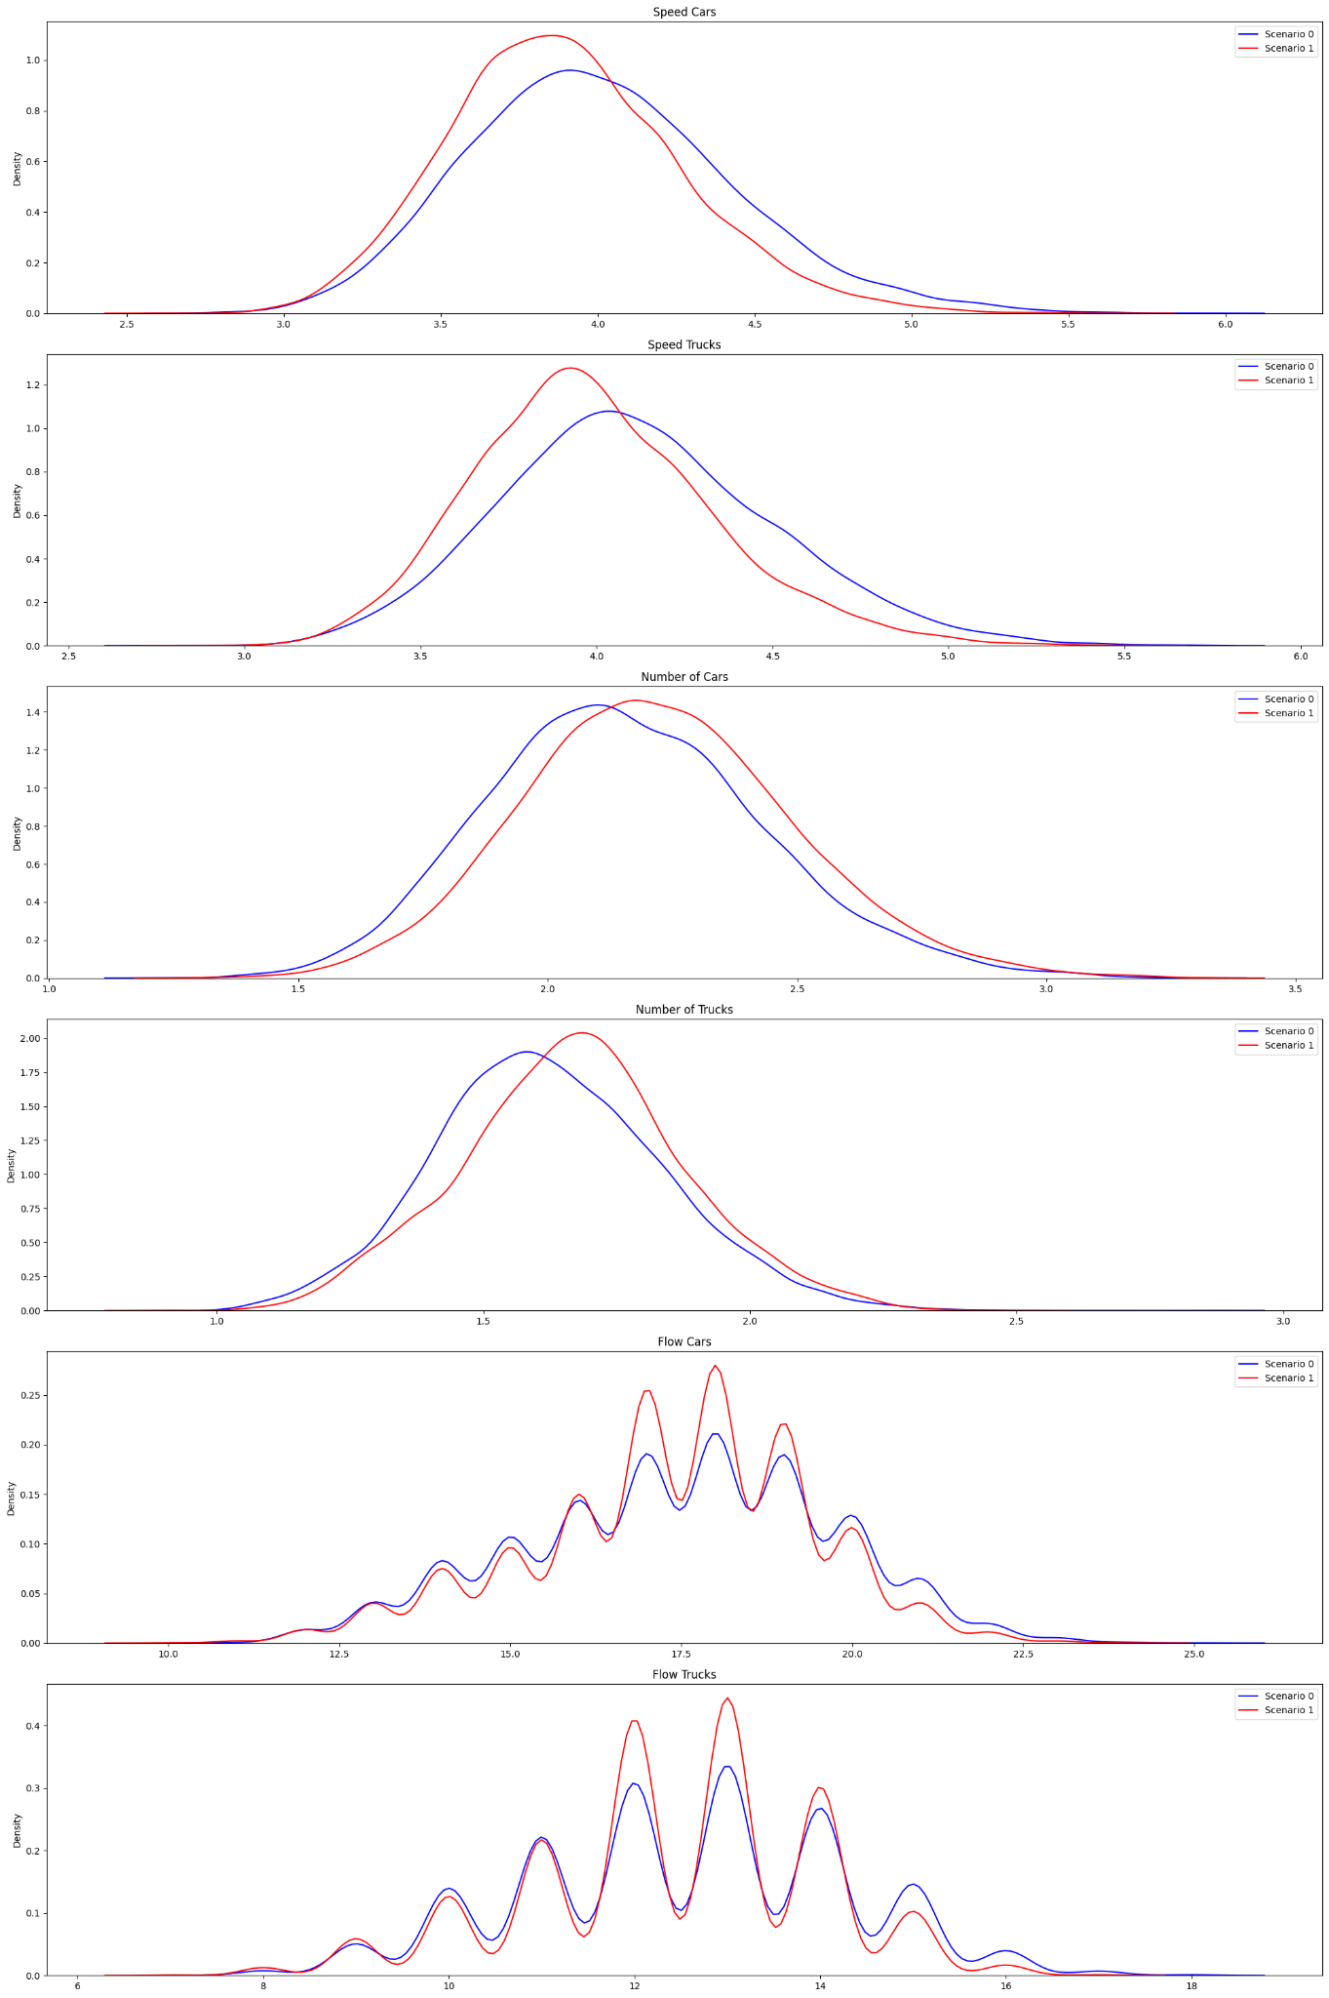
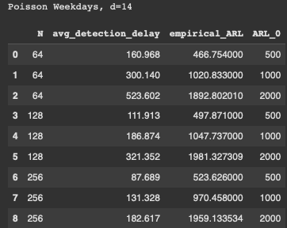
Poisson Weekday (d=14), qtree ewma (K=32)

Slide 9
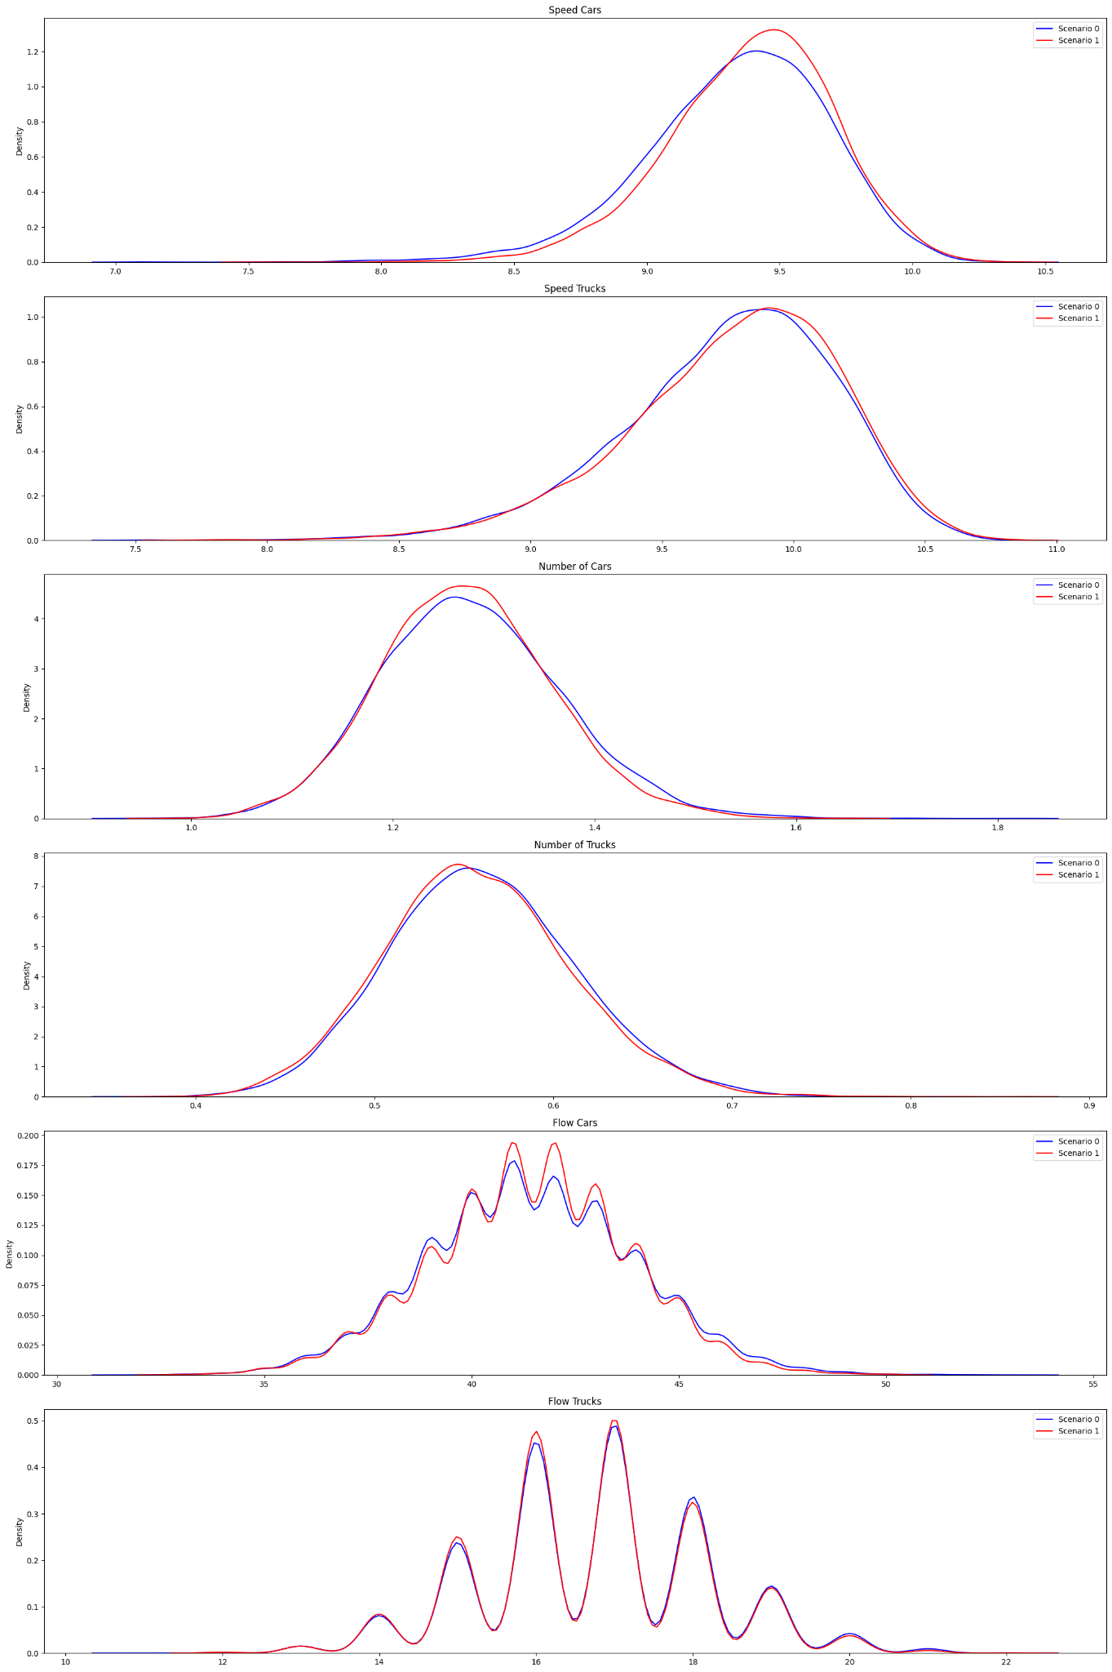
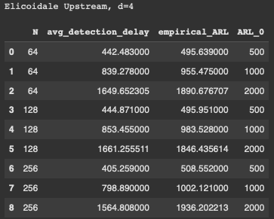
Poisson Weekday | Elicoidale Upstream (d=4), qtree ewma (K=32)

Slide 10
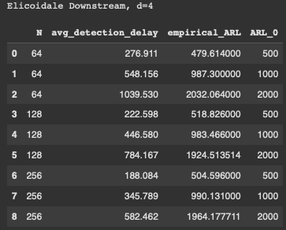
Poisson Weekday | Elicoidale Downstream (d=4), qtree ewma (K=32)

Slide 11
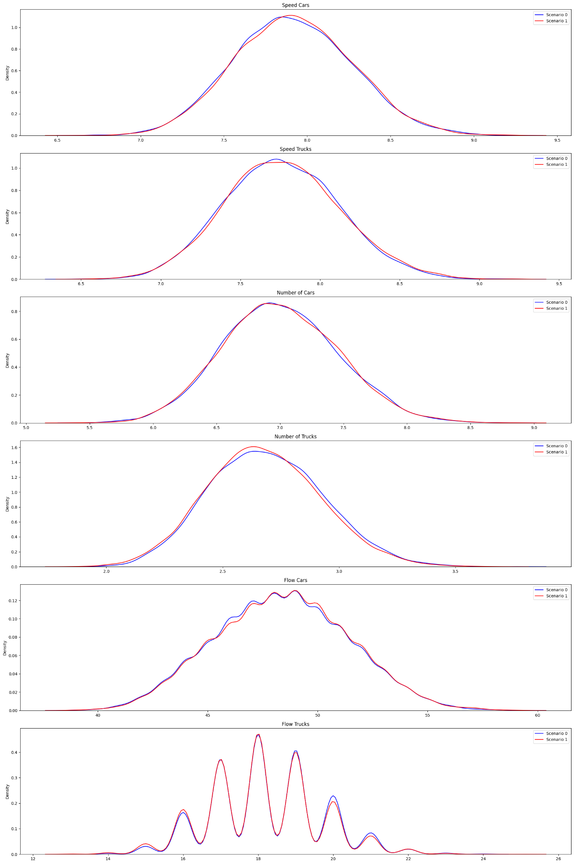
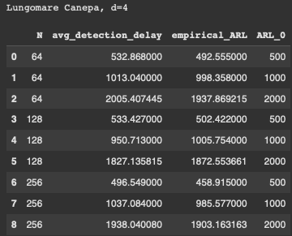
Poisson Weekday | Lungomare Canepa (d=4), qtree ewma (K=32)

Slide 12
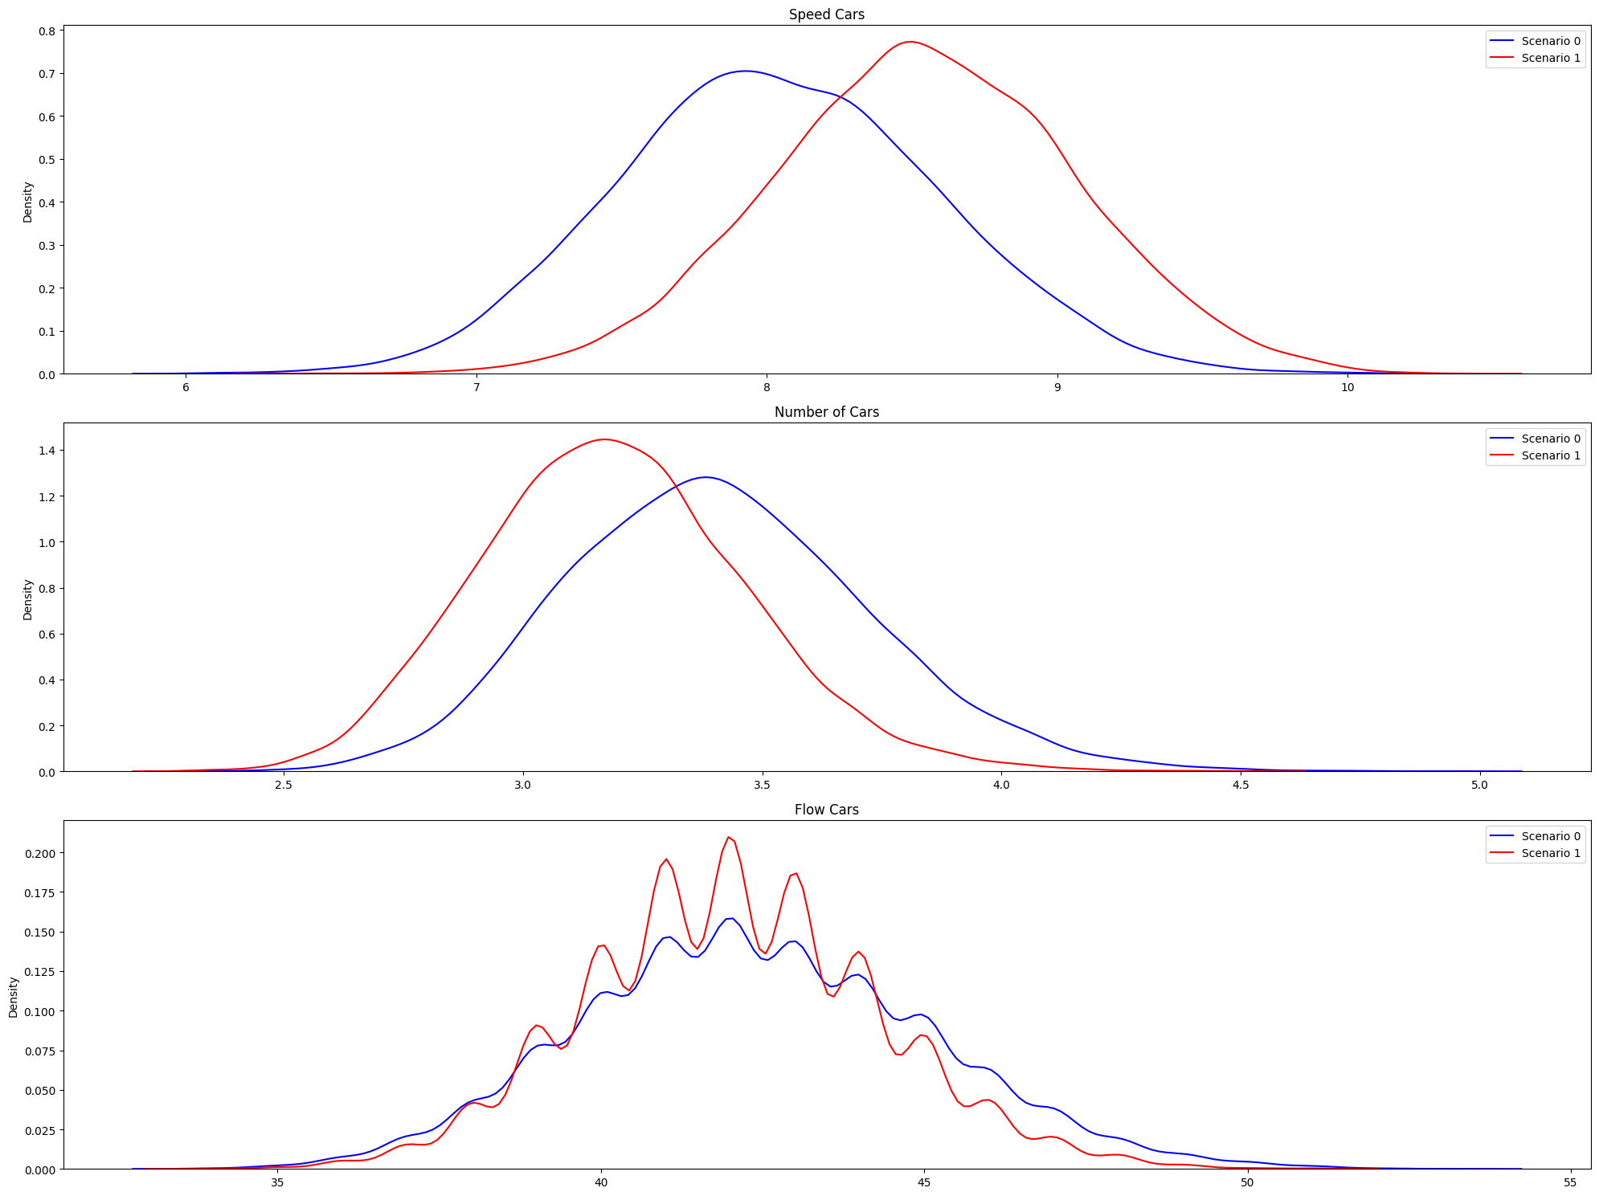
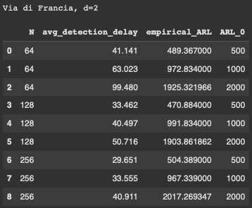
Poisson Weekday | Via di Francia (d=2), qtree ewma (K=32)

Slide 13
Multimodal Poisson
Inflows generated with poisson distribution
Multimodal: Weekday (50%) + Weekend (50%)
Scenario 0 → Scenario 1
The change is minimal: 5 seconds longer in a single red phase of a single traffic light.
Here we do not take into account “flow cars” or “flow trucks” when running QT EWMA

Slide 14
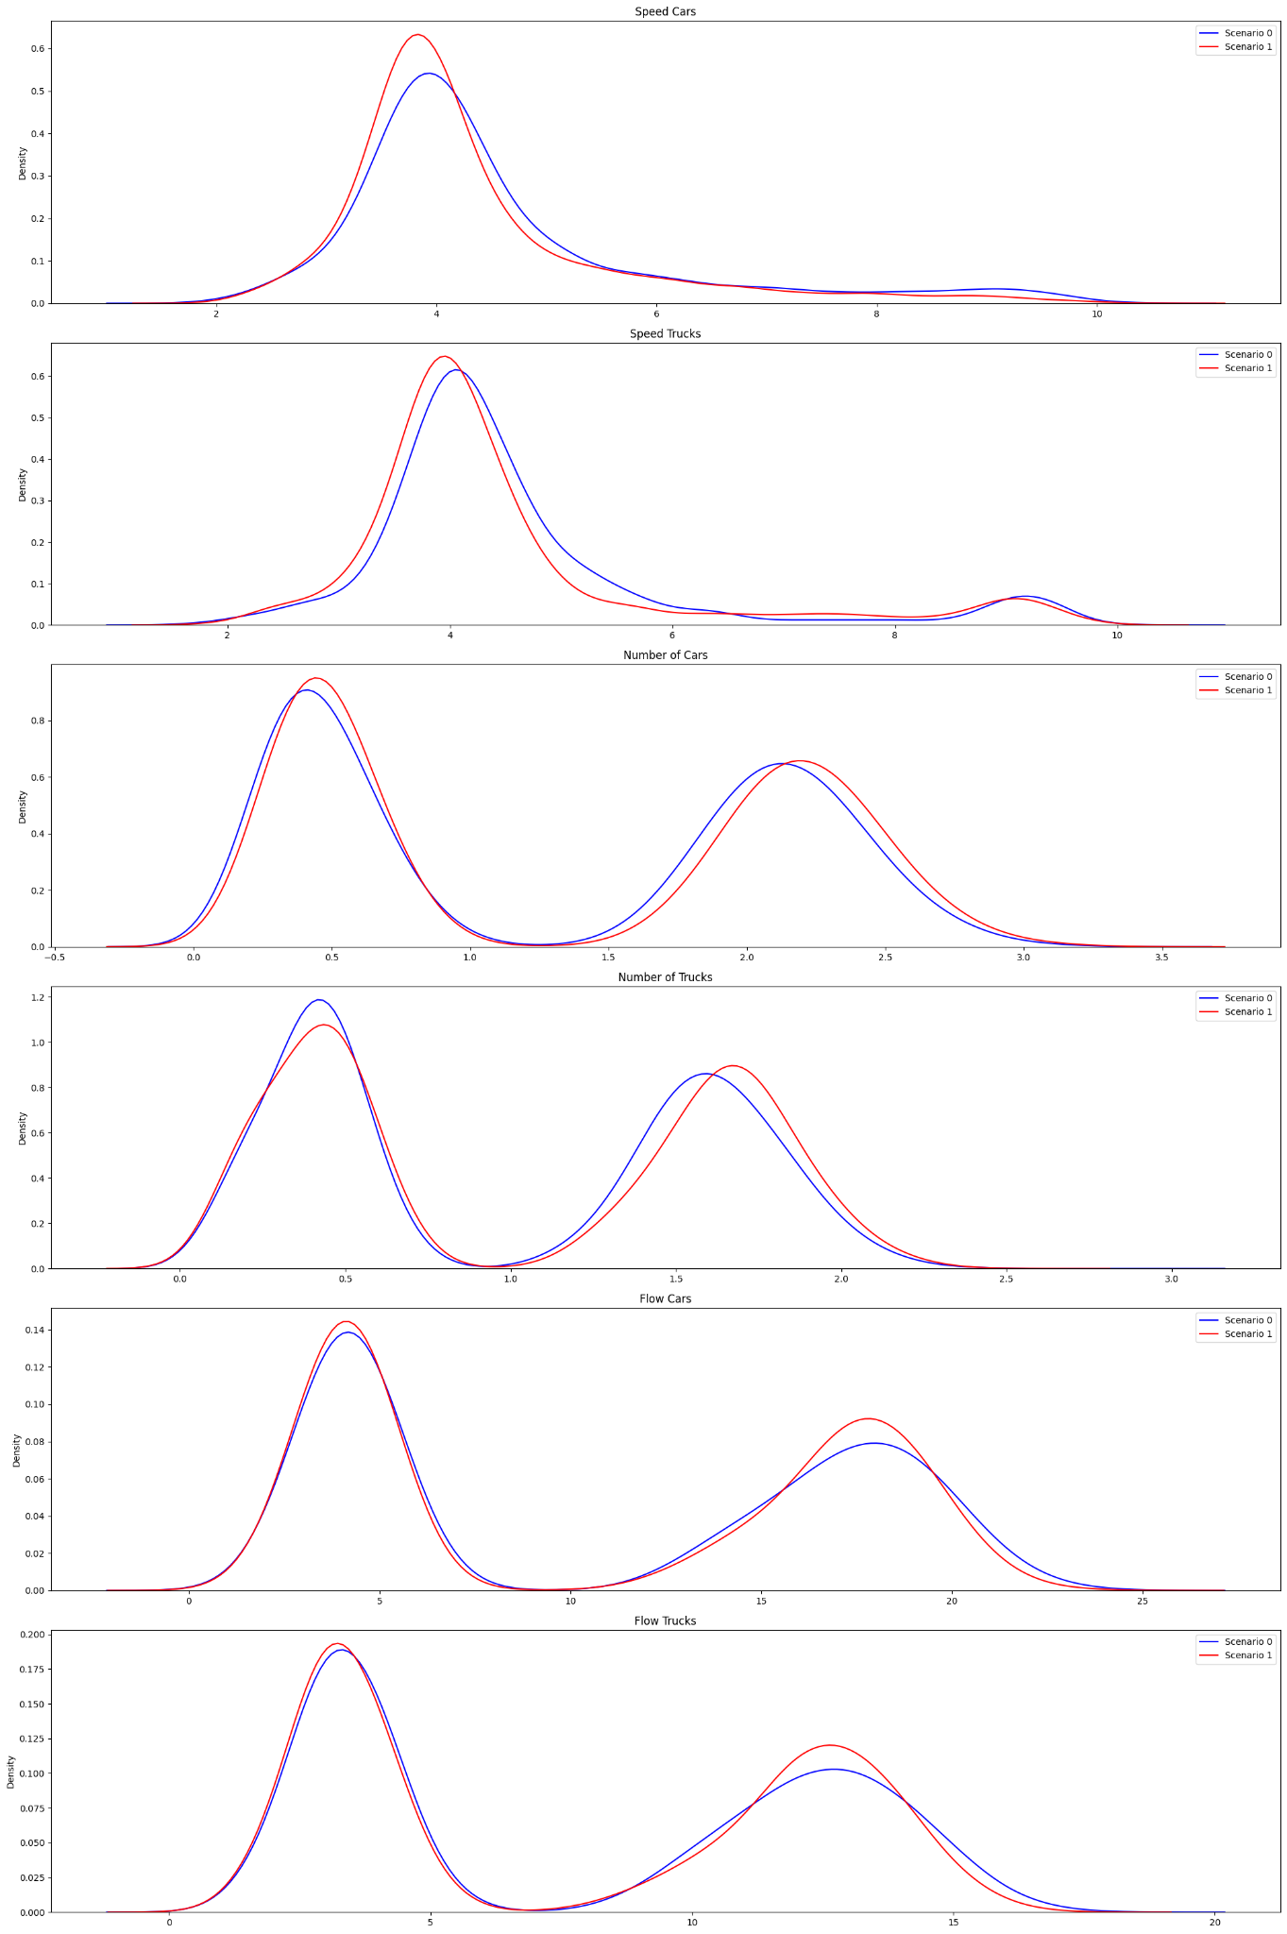
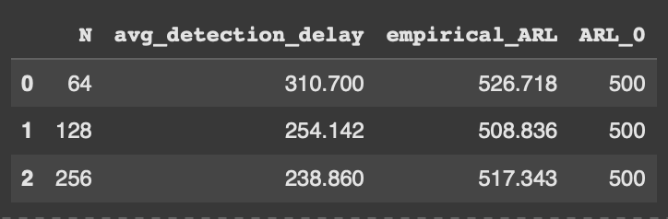
Multimodal Poisson (d=14), qtree ewma (K=32)

Slide 15
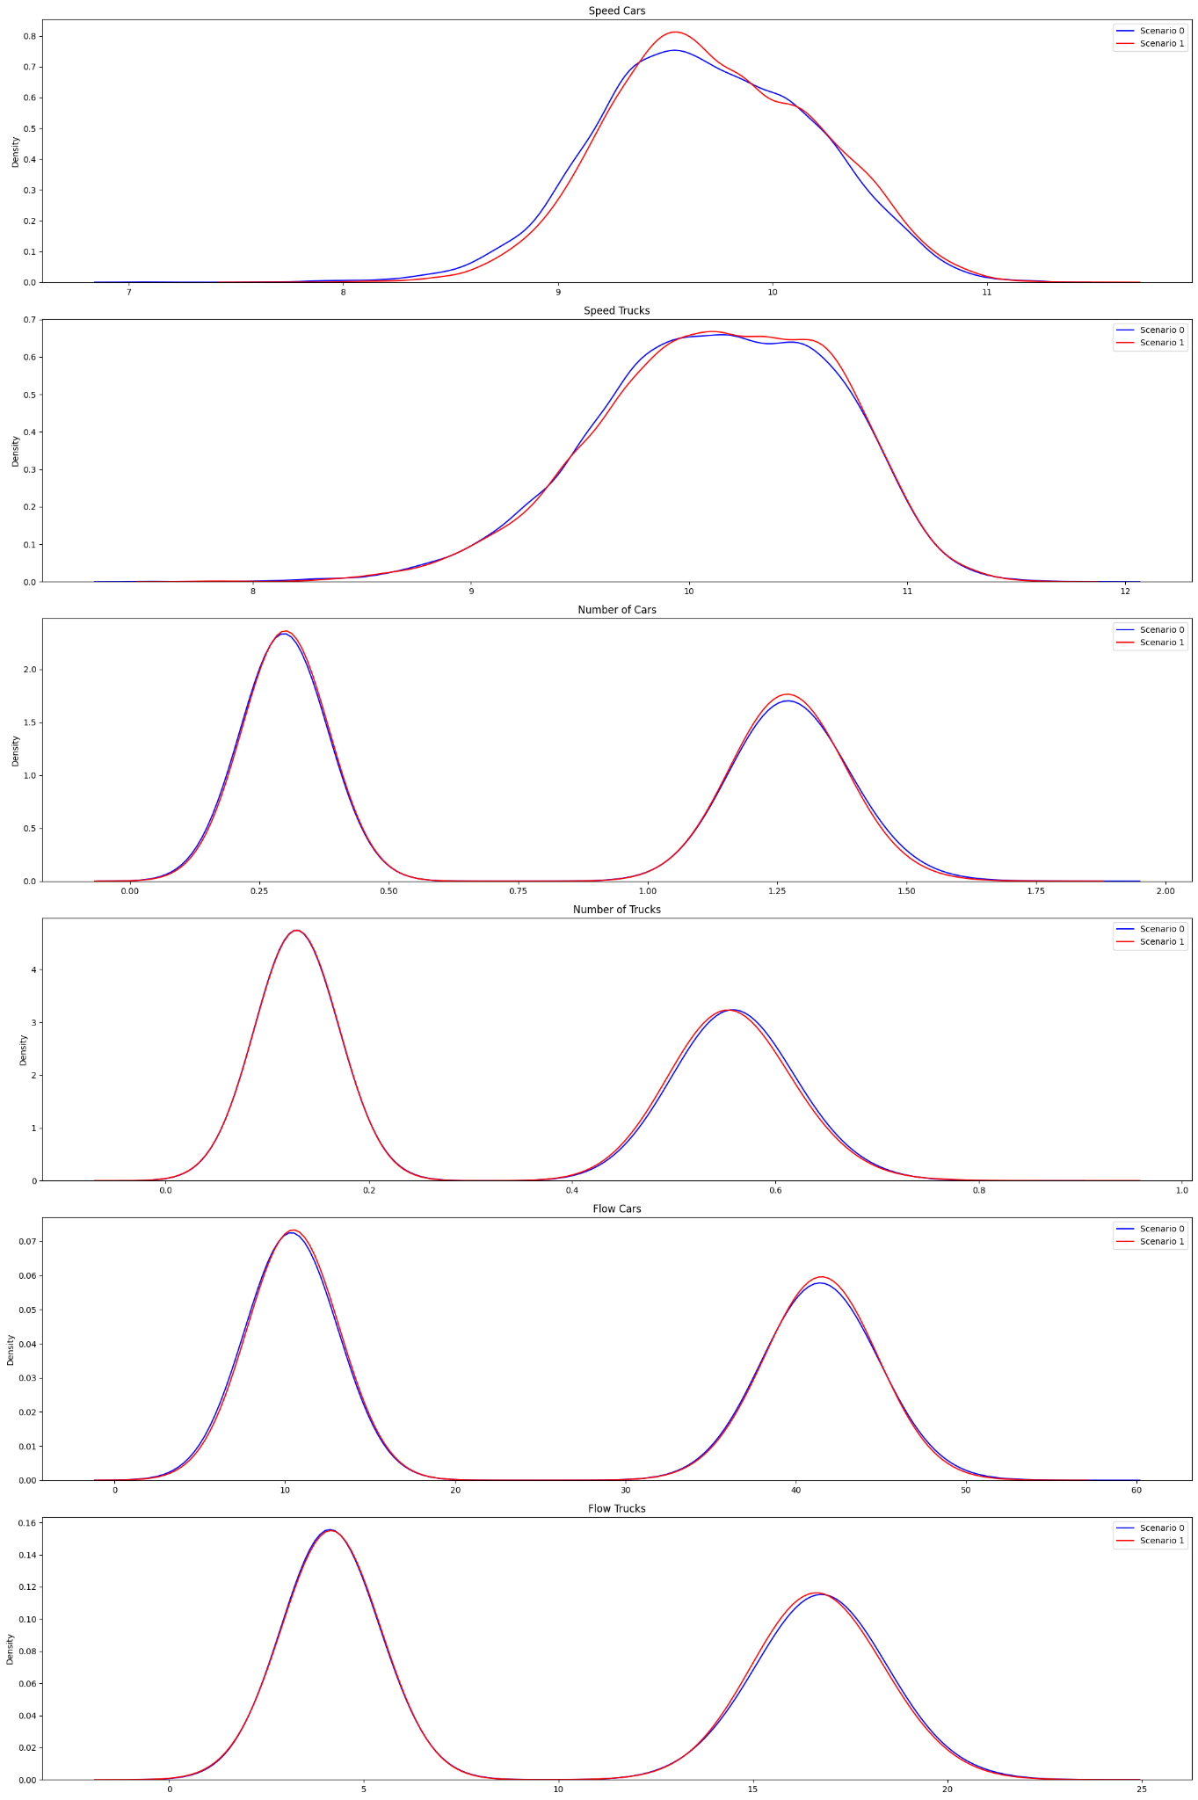
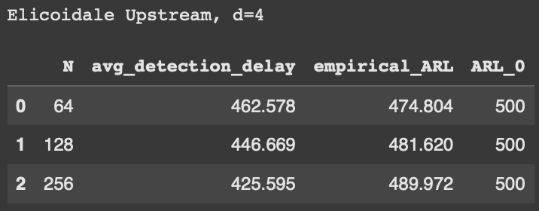
Multimodal Poisson | Elicoidale Upstream (d=4), qtree ewma (K=32)

Slide 16
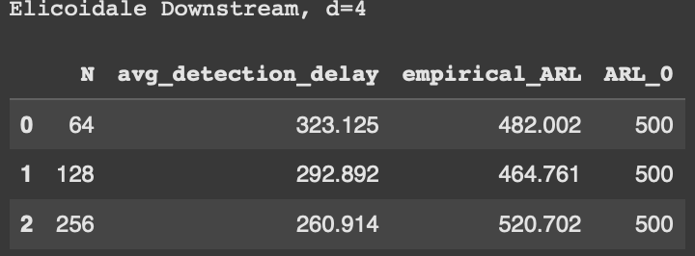
Multimodal Poisson | Elicoidale Downstream (d=4), qtree ewma (K=32)

Slide 17
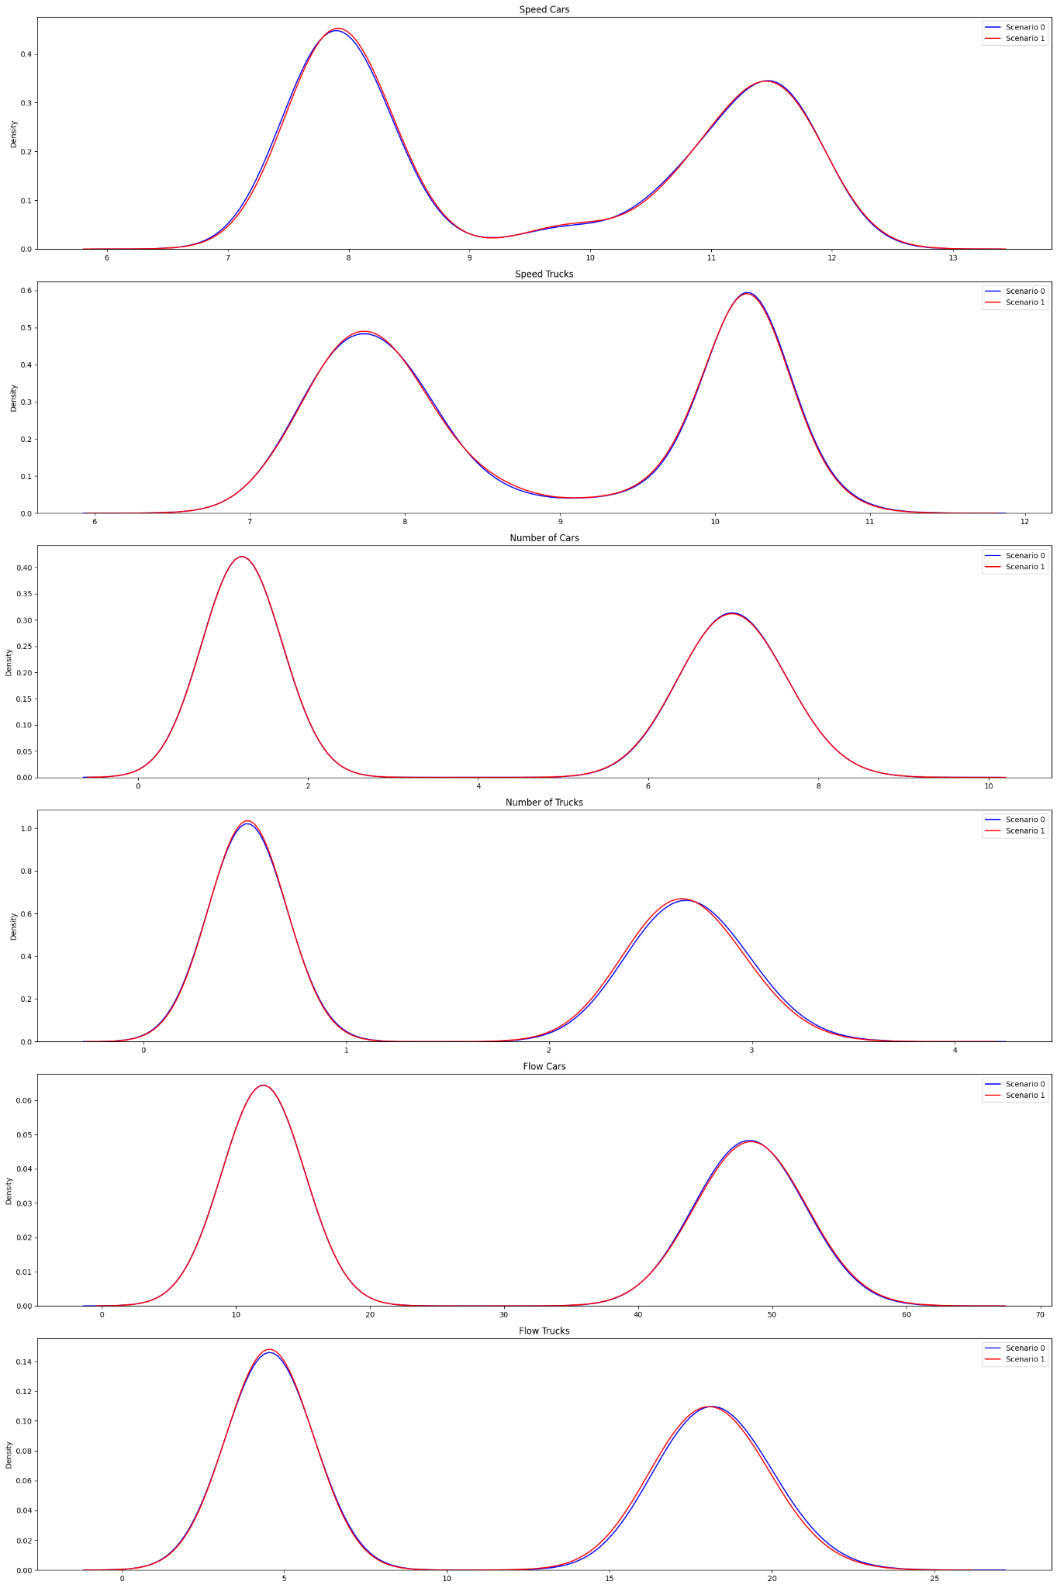
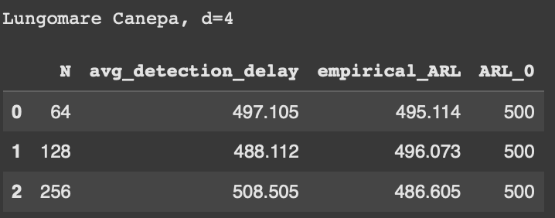
Multimodal Poisson | Lungomare Canepa (d=4), qtree ewma (K=32)

Slide 18
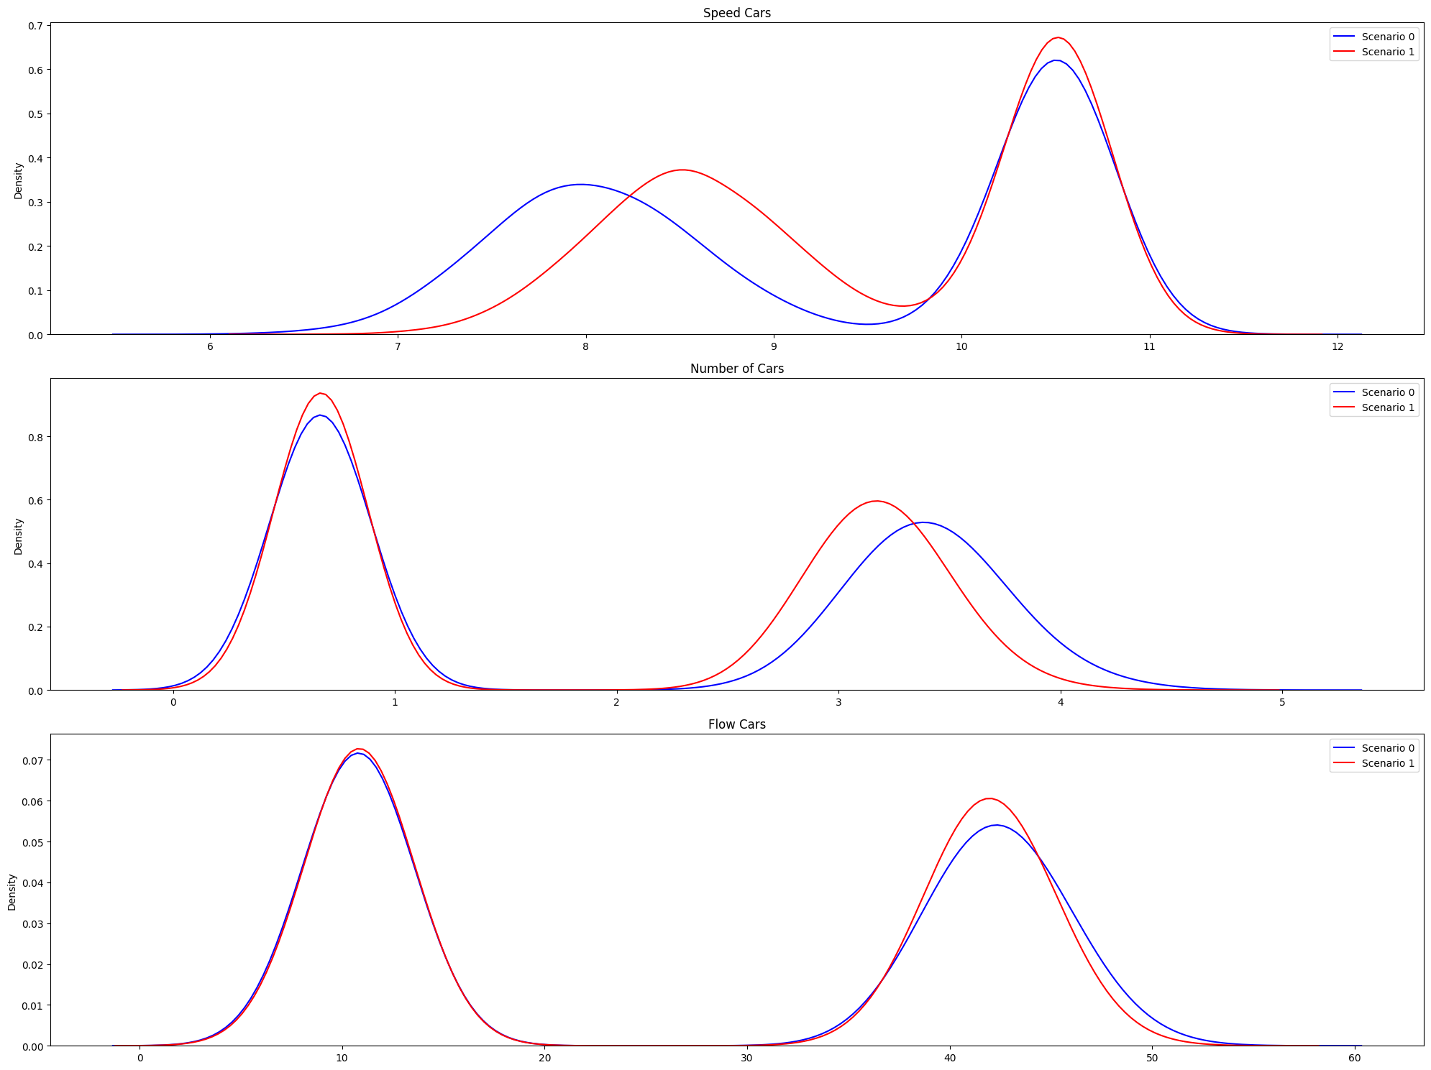
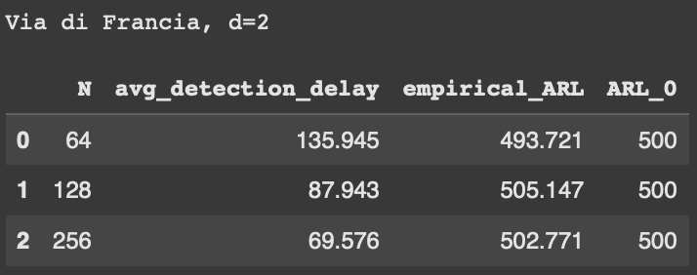
Multimodal Poisson | Via di Francia (d=2), qtree ewma (K=32)

Slide 19
Uniform
Uniform (100%)
+
Uniform in “weekend” conditions (0%)
Scenario 0: basic conditions with added some ferry passengers traffic.
Scenario 1: alternative policy keeping the basic scenario and changed slightly the timing of two traffic lights.
Here we are considering only the weekdays.
Here we do not take into account “flow cars” or “flow trucks” when running QT EWMA

Slide 20
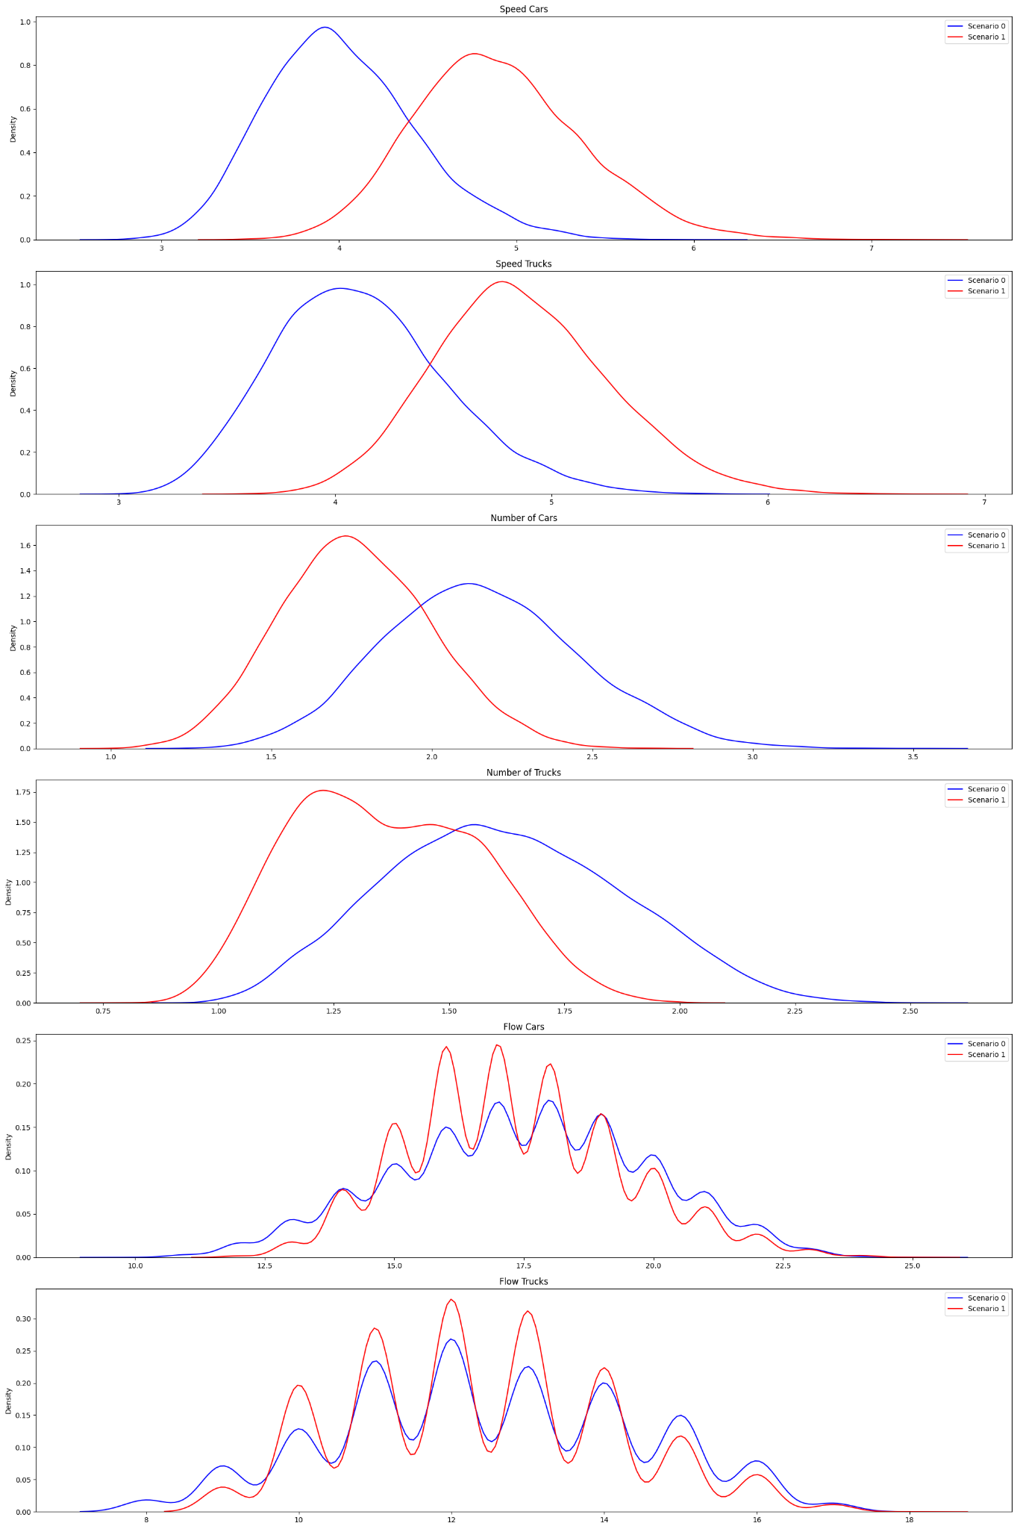
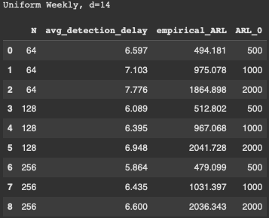
Uniform Weekday (d=14), qtree ewma (K=32)

Slide 21
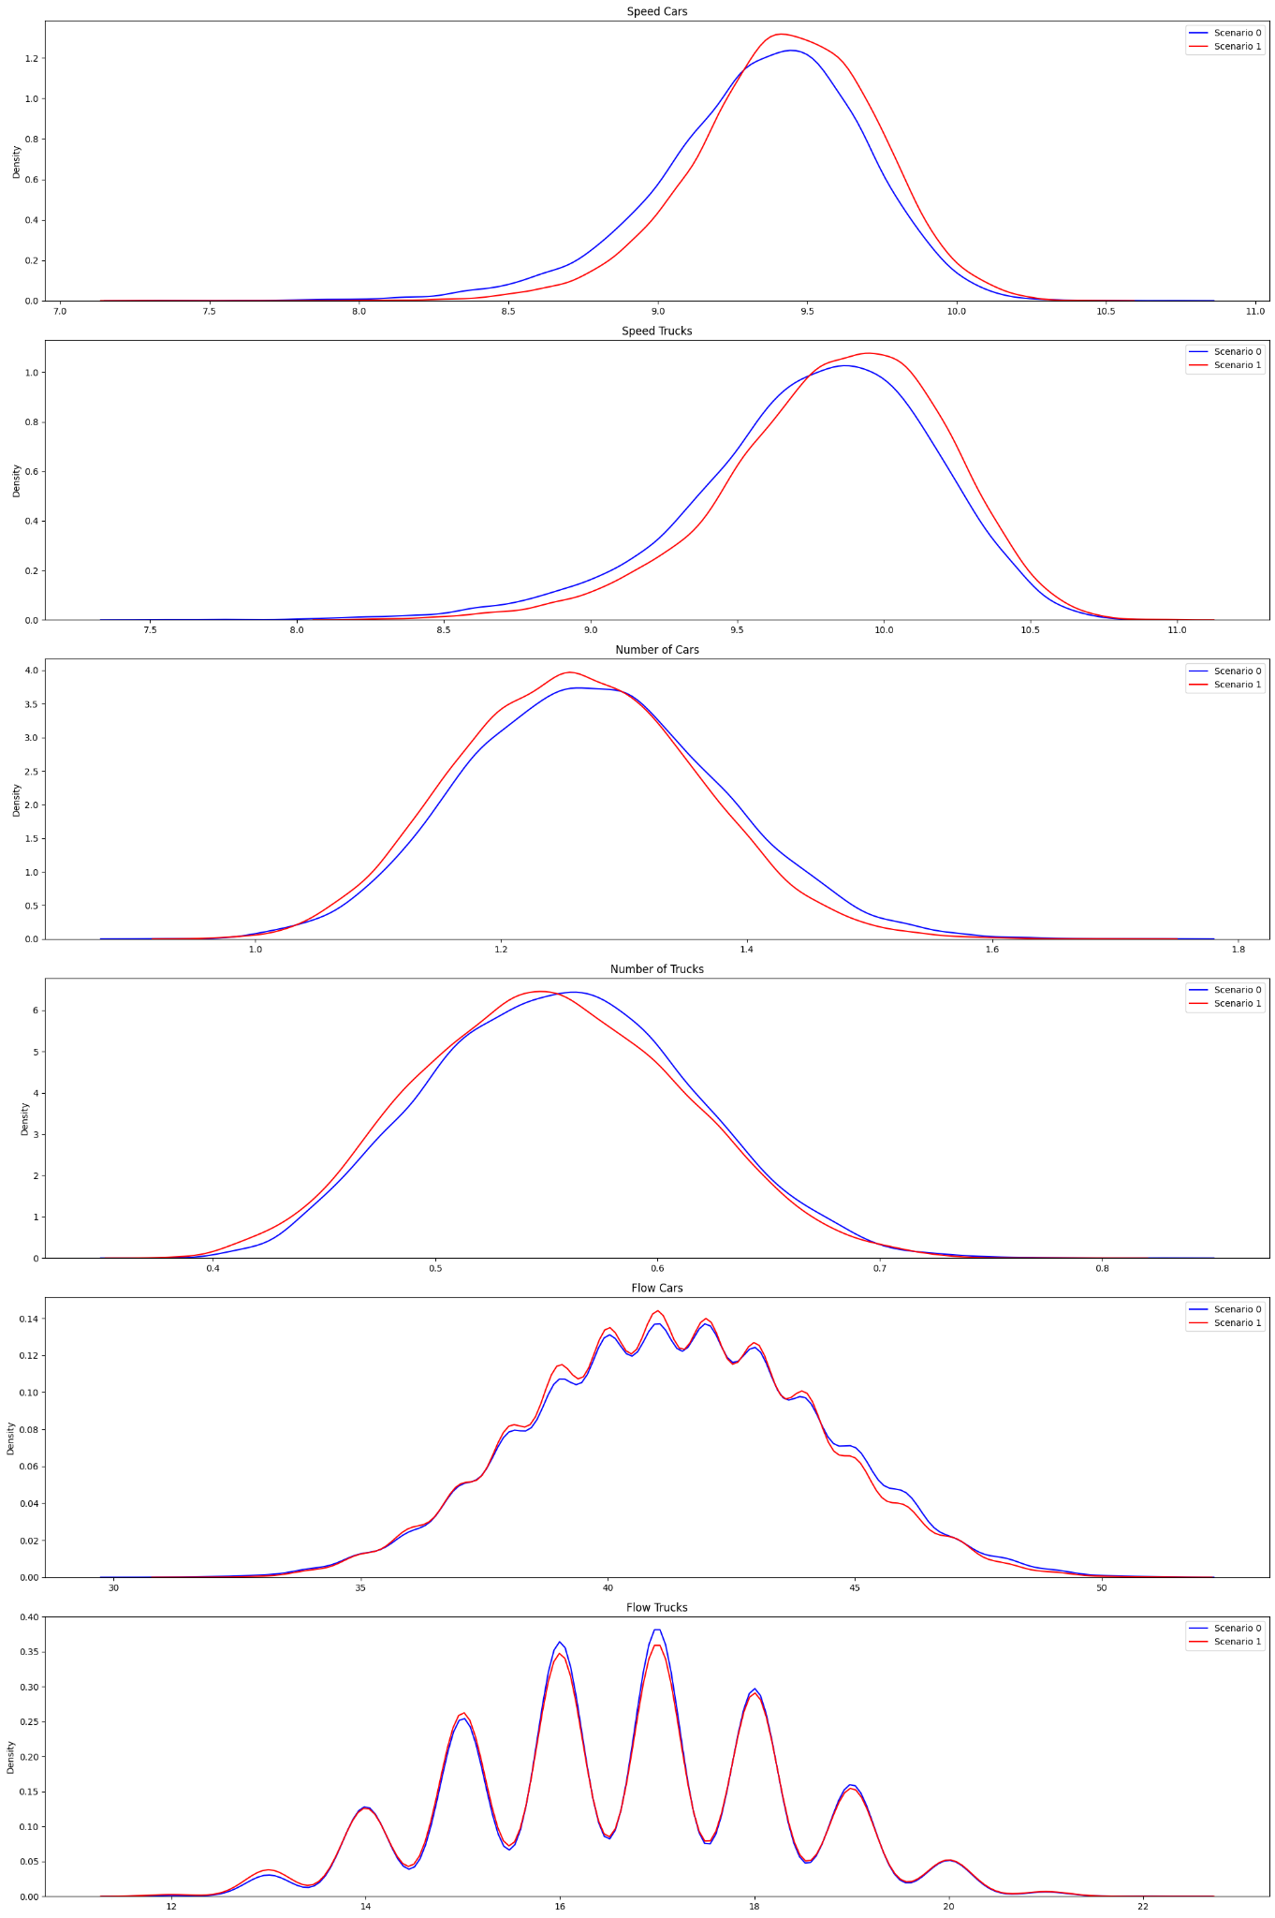
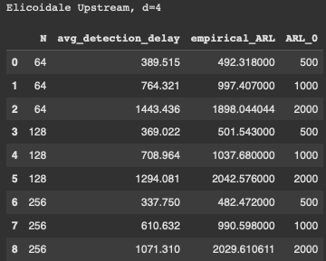
Uniform Weekday | Elicoidale Upstream (d=4), qtree ewma (K=32)

Slide 22
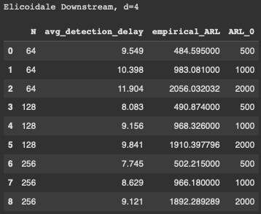
Uniform Weekday | Elicoidale Downstream (d=4), qtree ewma (K=32)

Slide 23
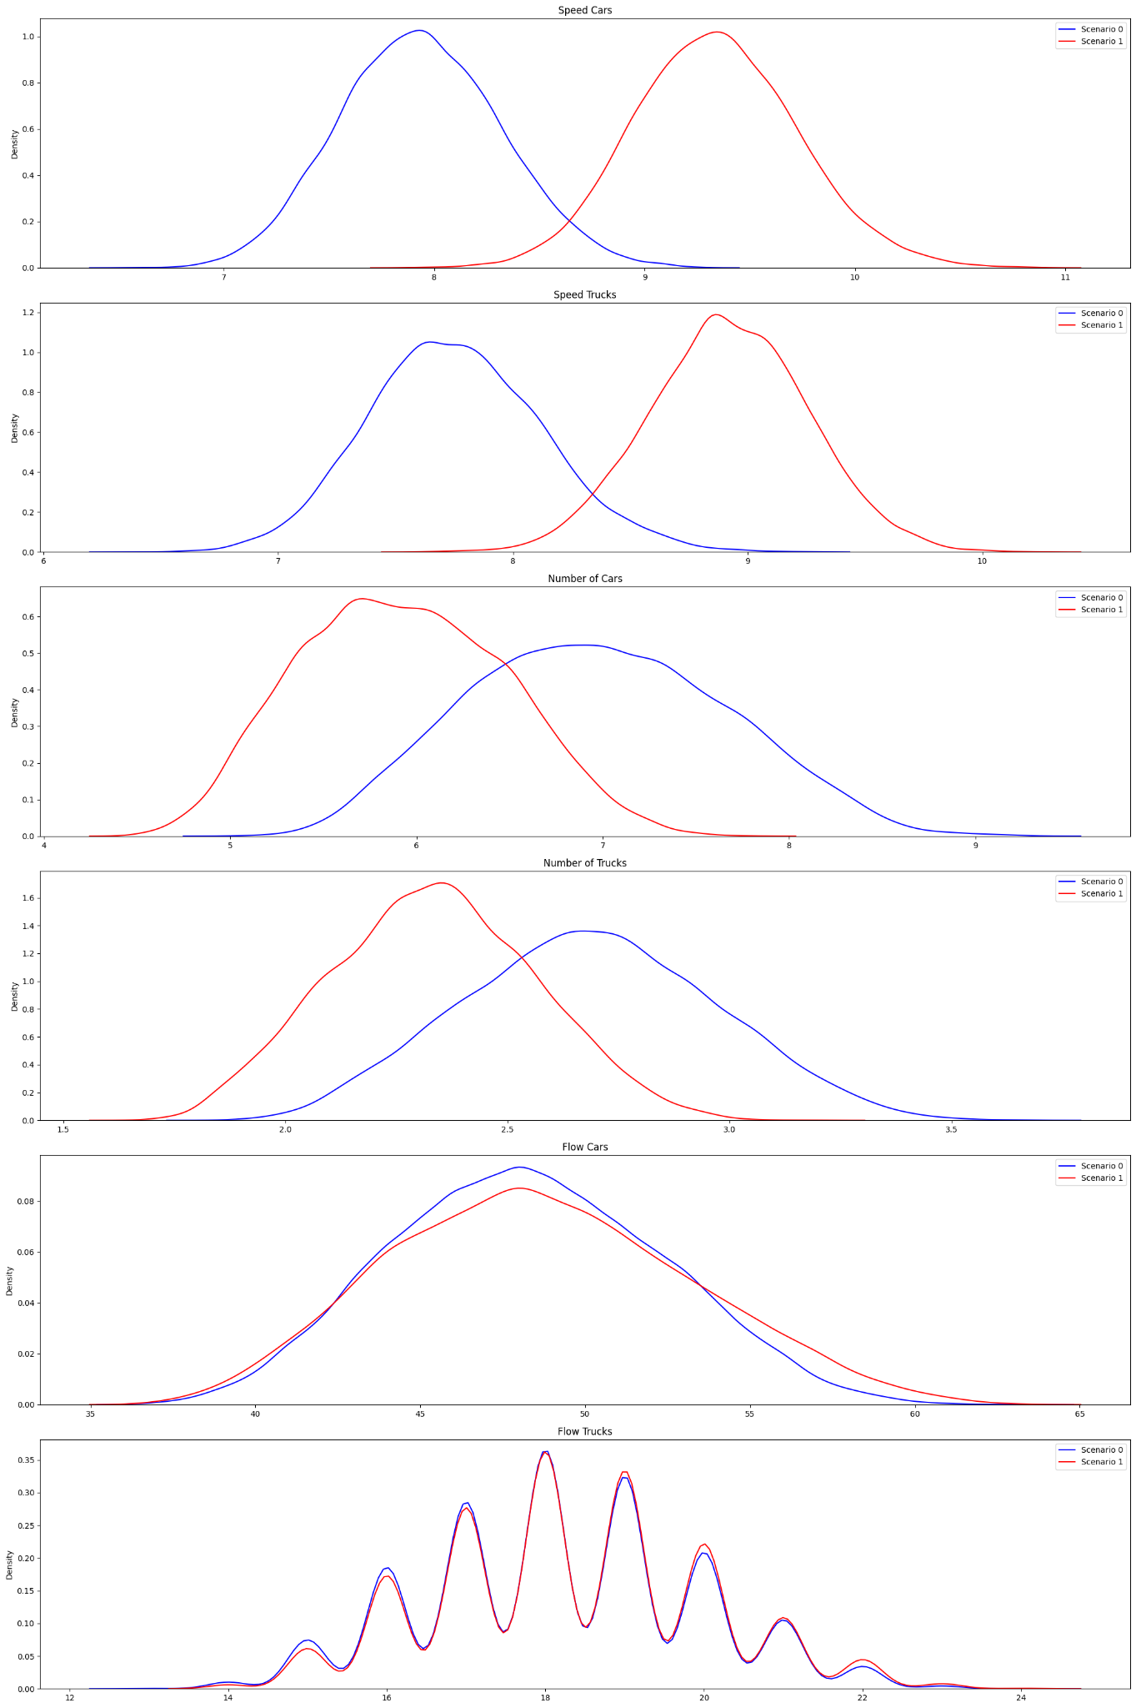
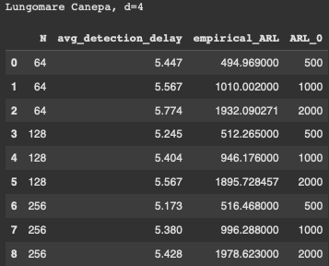
Uniform Weekday | Lungomare Canepa (d=4), qtree ewma (K=32)

Slide 24
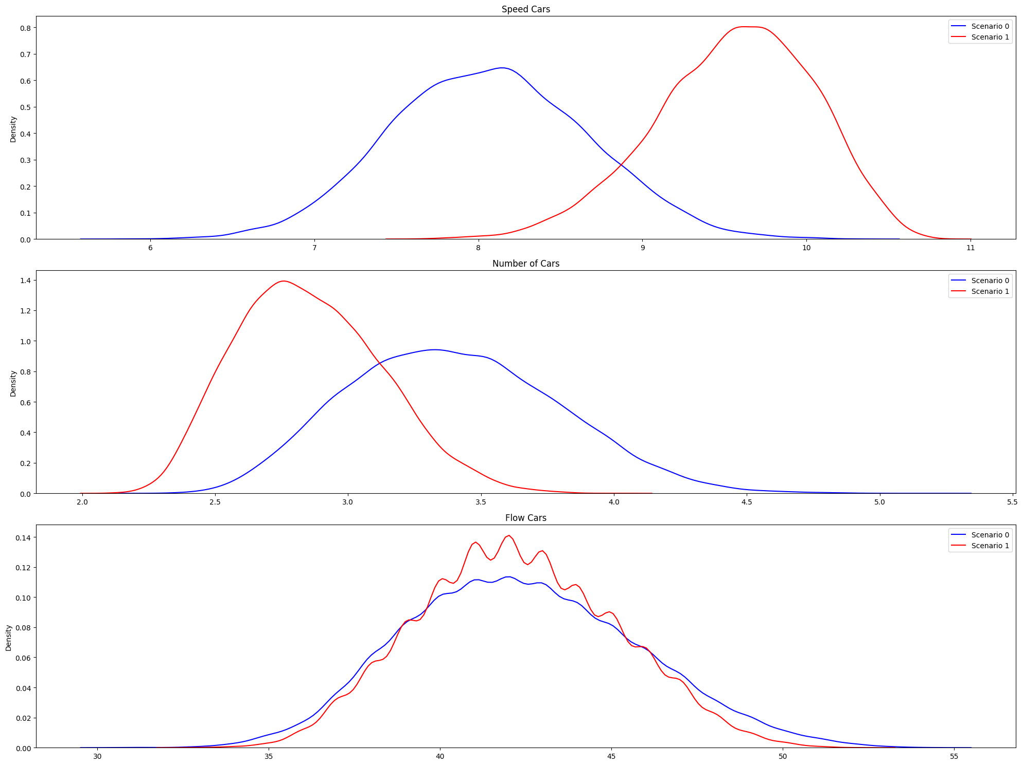
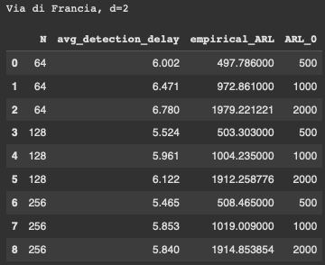
Uniform Weekday | Via di Francia (d=2), qtree ewma (K=32)

Slide 25
Multimodal Uniform
Uniform (50%)
+
Uniform in “weekend” conditions (50%)
Scenario 0: basic conditions with added some ferry passengers traffic.
Scenario 1: alternative policy keeping the basic scenario and changed slightly the timing of two traffic lights.
Here we do not take into account “flow cars” or “flow trucks” when running QT EWMA

Slide 26
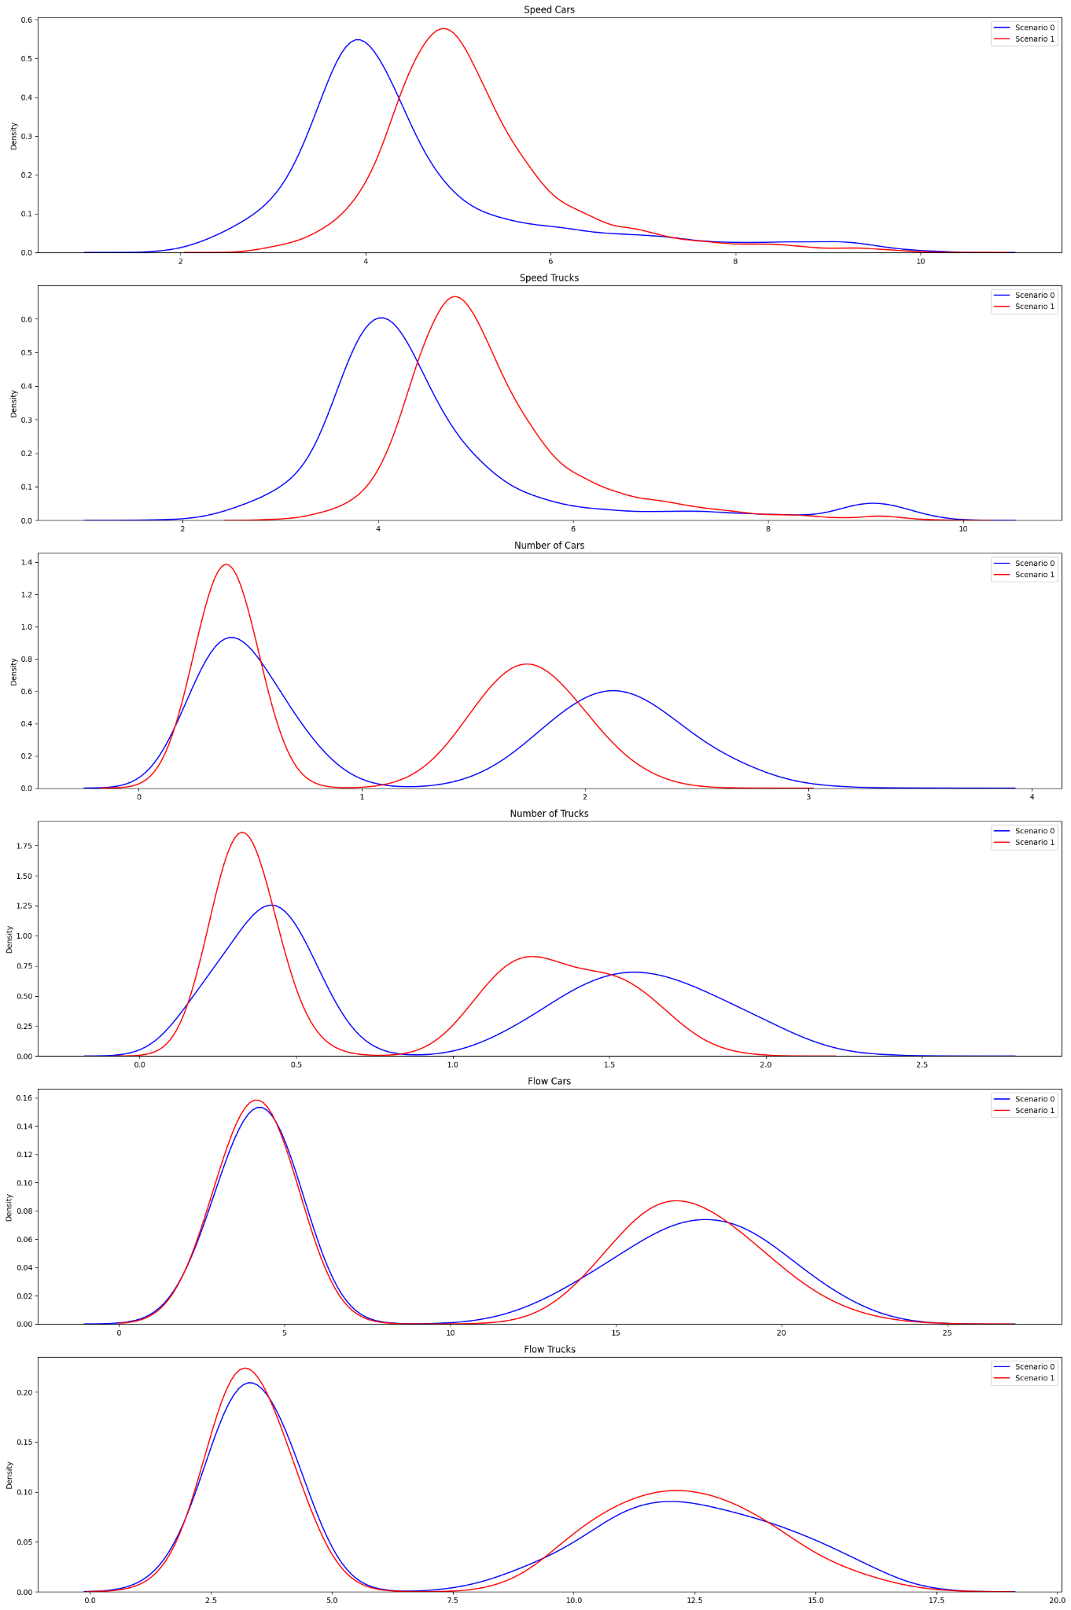
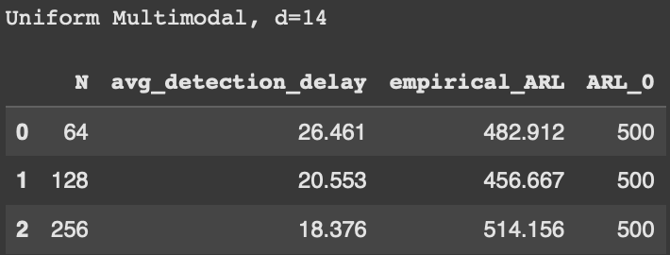
Multimodal Uniform (d=14), qtree ewma (K=32)

Slide 27
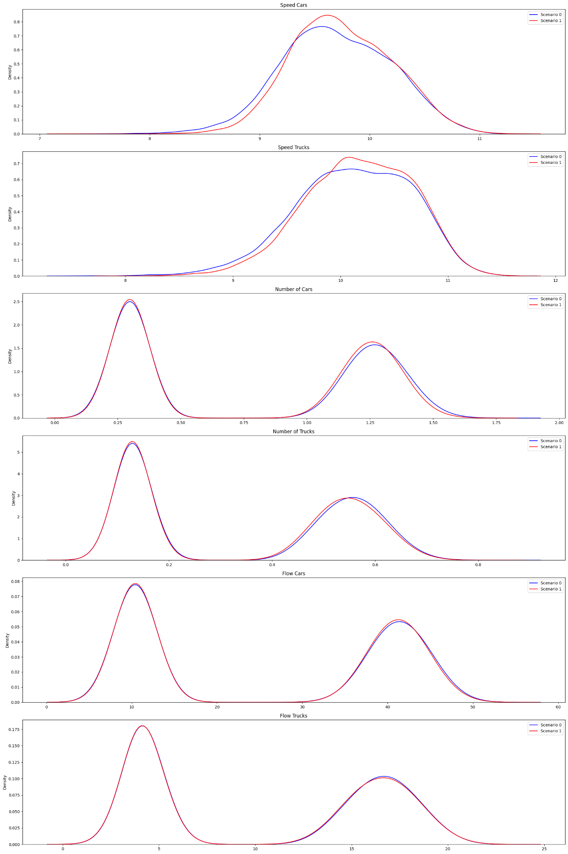
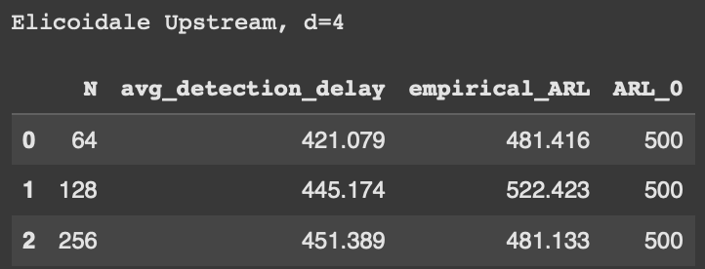
Multimodal Uniform | Elicoidale Upstream (d=4), qtree ewma (K=32)

Slide 28
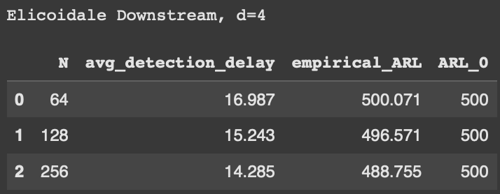
Multimodal Uniform | Elicoidale Downstream (d=4), qtree ewma (K=32)

Slide 29
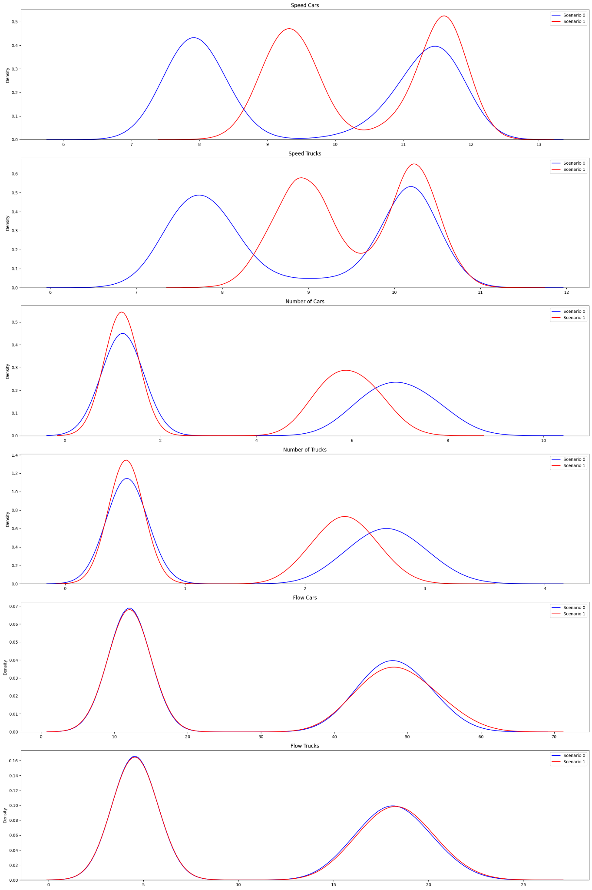
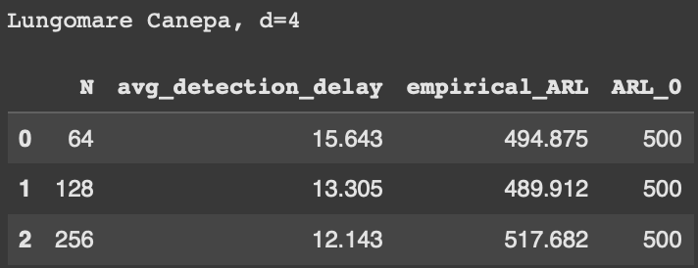
Multimodal Uniform | Lungomare Canepa (d=4), qtree ewma (K=32)

Slide 30
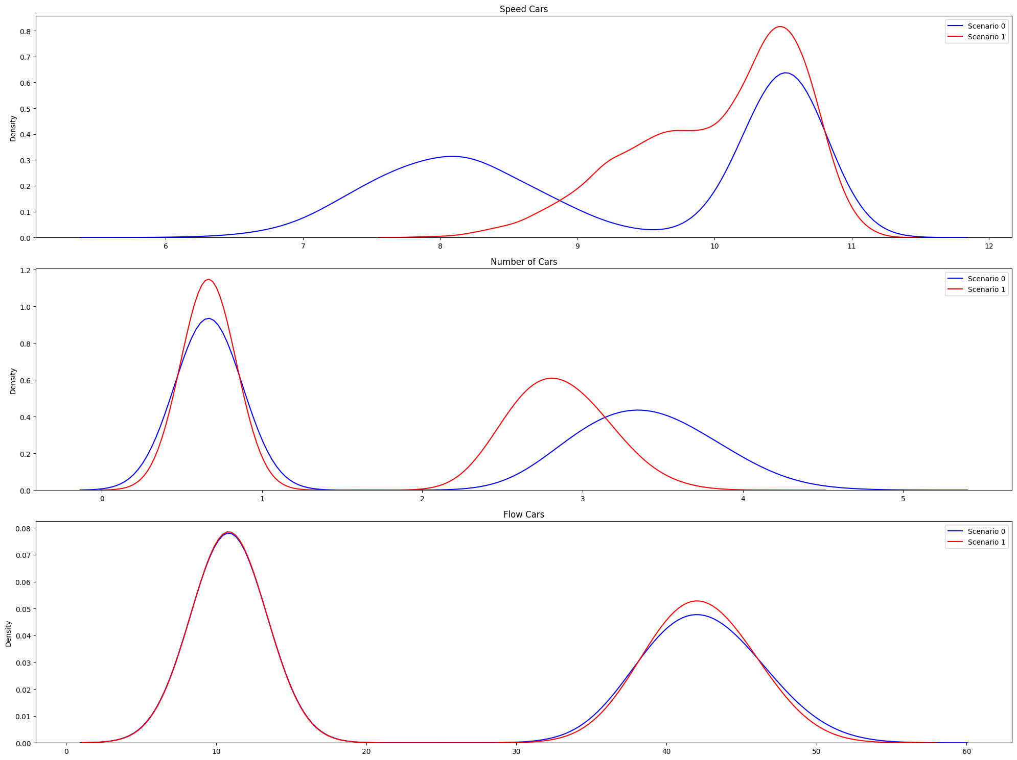
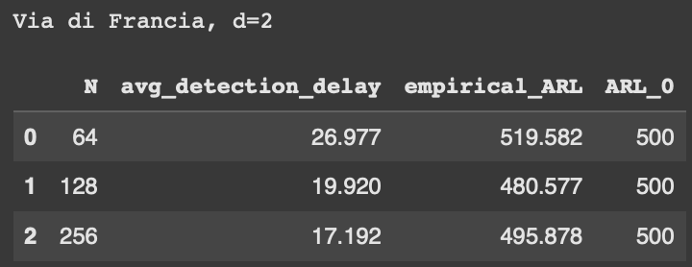
Multimodal Uniform | Via di Francia (d=2), qtree ewma (K=32)

Slide 31
Gaussian
Inflows generated with gaussian distribution
Scenario 0: basic conditions with added some ferry passengers traffic.
Scenario 1: alternative policy, one of the port gates is closed, forcing trucks to reroute.
Here we do not take into account “flow cars” or “flow trucks” when running QT EWMA

Slide 32
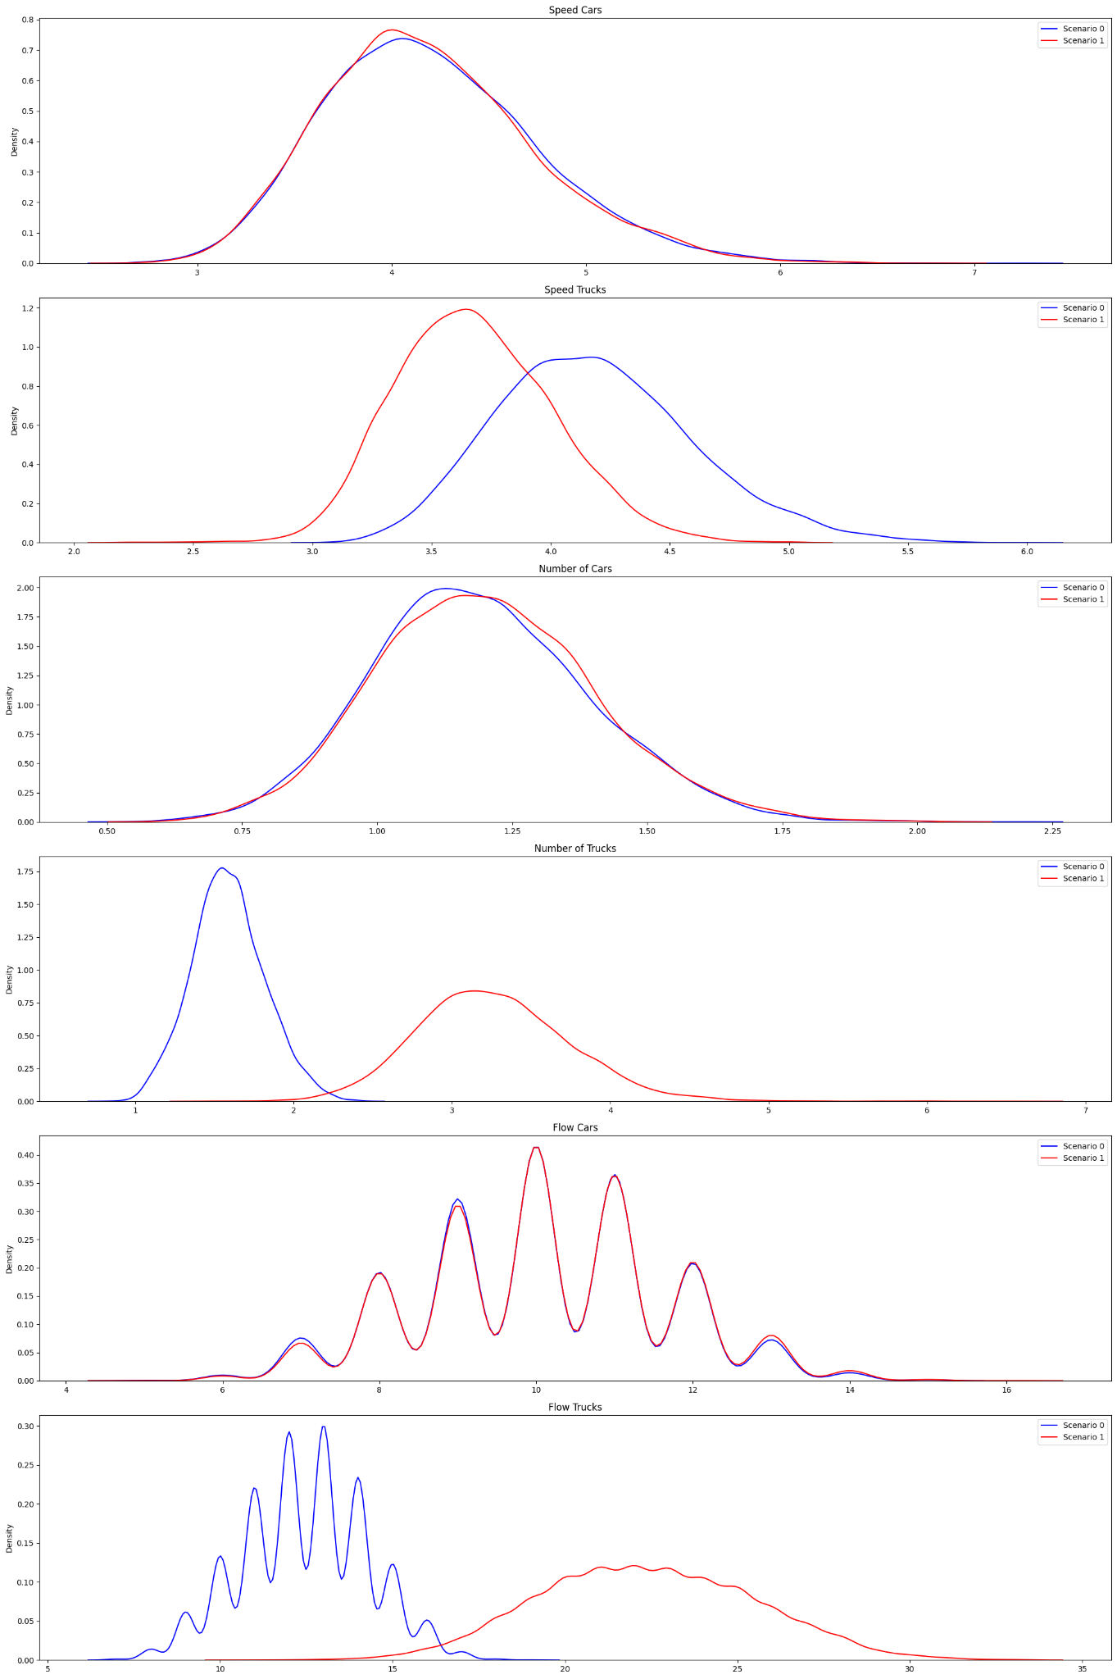

Gaussian (d=14), qtree ewma (K=32)

Slide 33
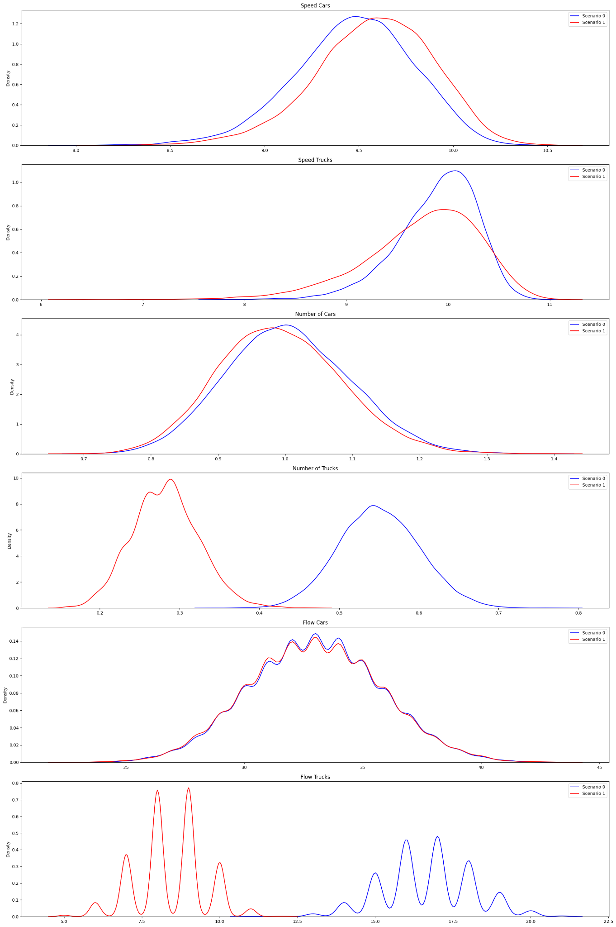
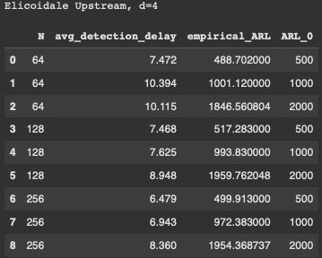
Gaussian | Elicoidale Upstream (d=4), qtree ewma (K=32)

Slide 34
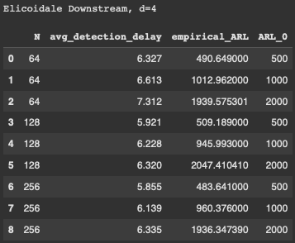
Gaussian | Elicoidale Downstream (d=4), qtree ewma (K=32)

Slide 35
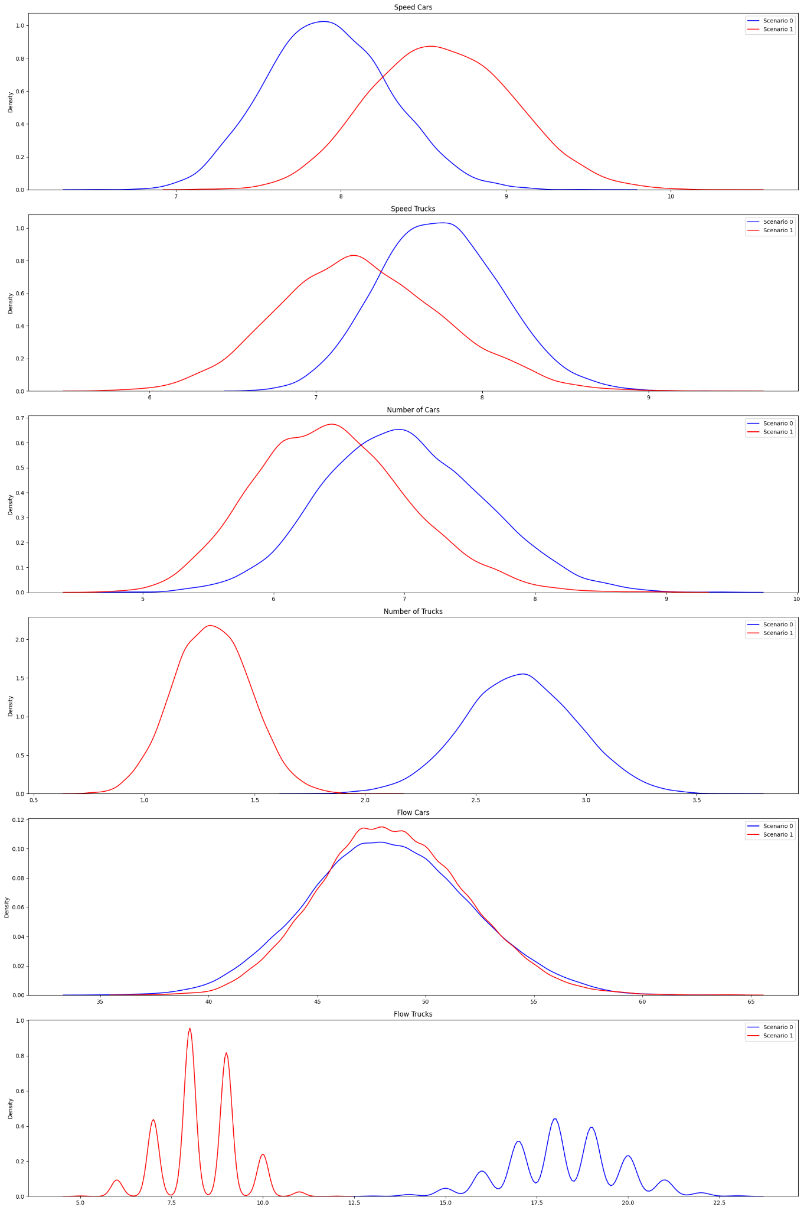
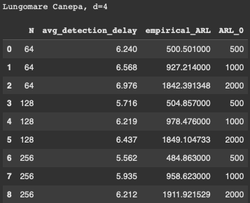
Gaussian | Lungomare Canepa (d=4), qtree ewma (K=32)

Slide 36
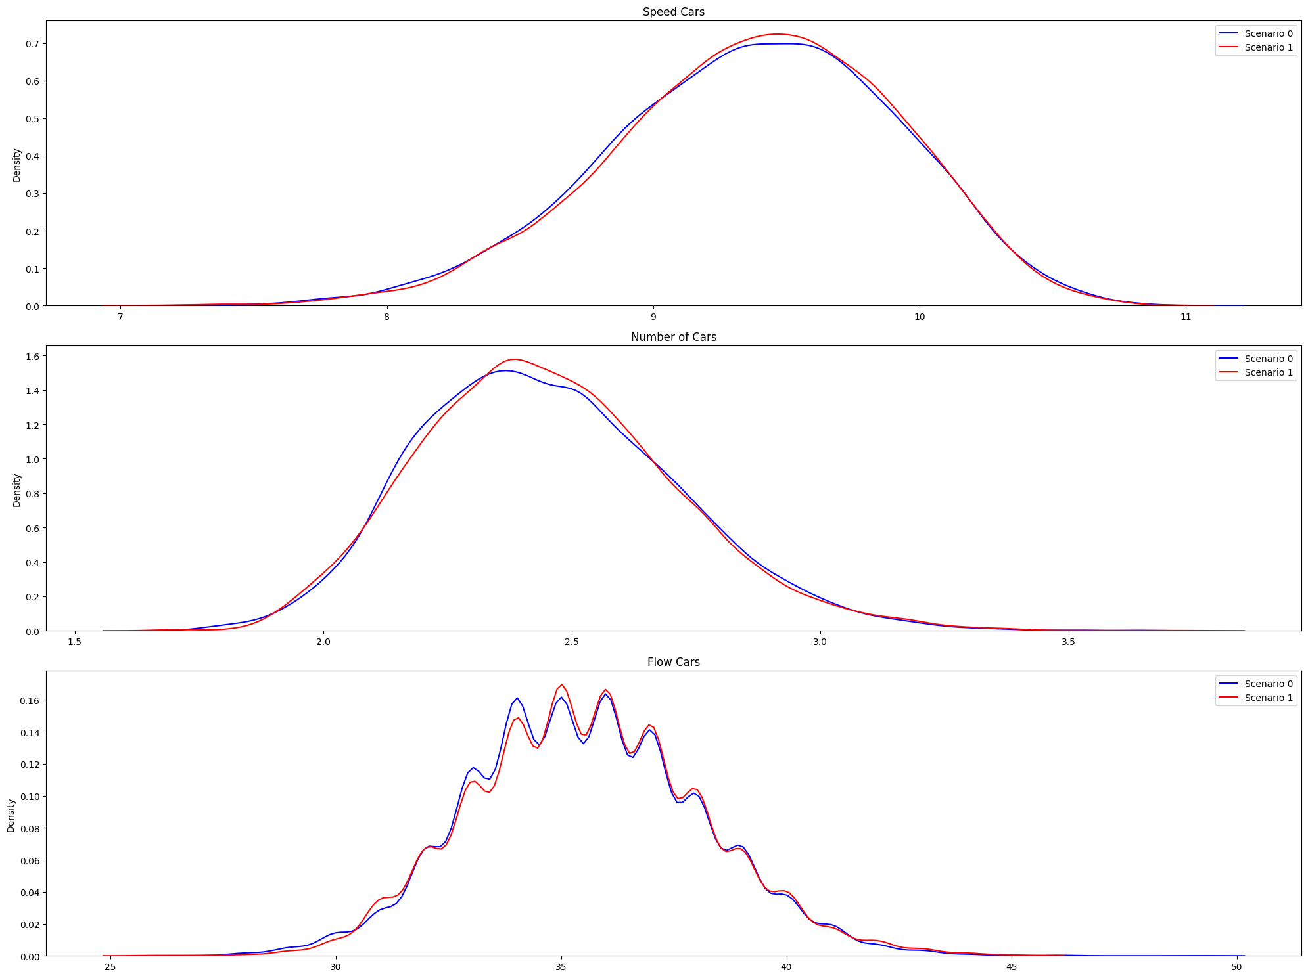
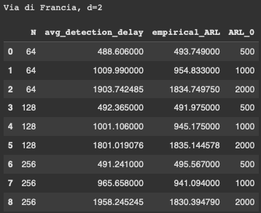
Gaussian | Via di Francia (d=2), qtree ewma (K=32)

Slide 37
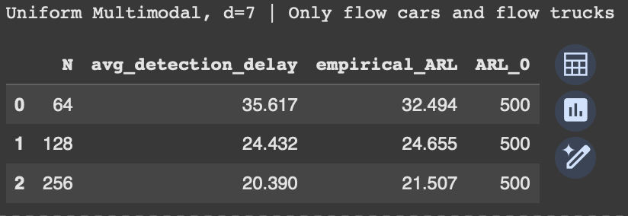
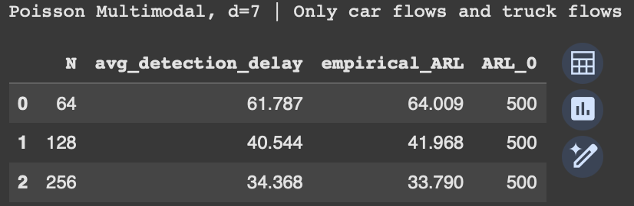

Slide 38
